Slide 1
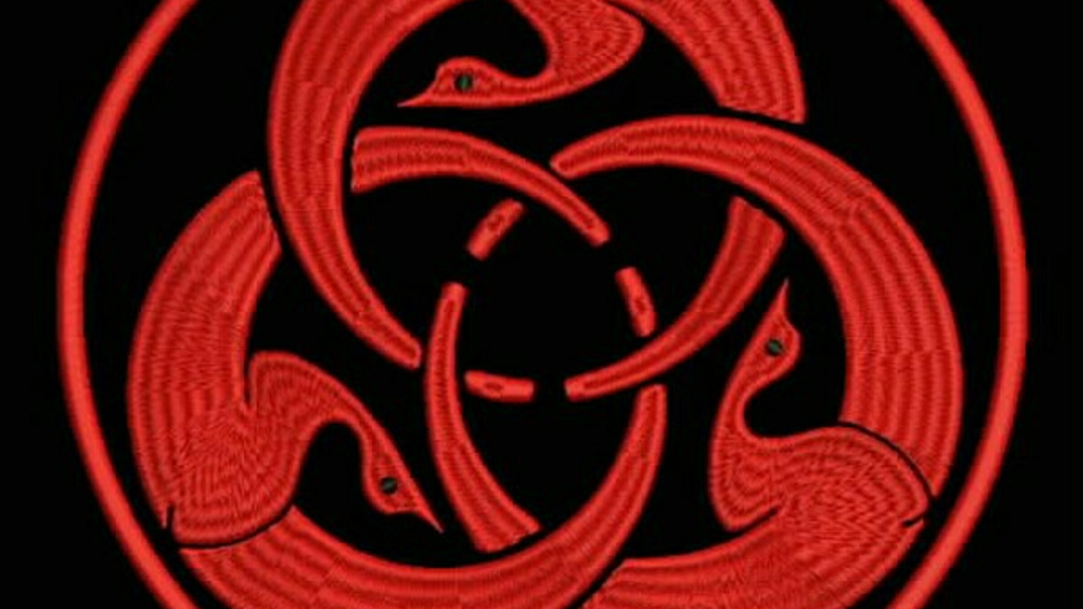

MANIFESTO · 01
BLOOD-RED ON BLACK
THE TREE
OF LIBERTY
A MANIFESTO IN ONE TRANSACTION
BITCOIN ONLY
NO KYC
NO MASTER

Slide 2
MANIFESTO
THOMAS JEFFERSON · 1787
FIG. 01 · CONCENTRIC ORDER
“The tree of liberty must be refreshed from time to time with the blood of patriots & tyrants. It is its natural manure.”
— THOMAS JEFFERSON, LETTER TO WILLIAM STEPHENS SMITH, NOV 13, 1787
PARS QUOD BELLUM

Slide 3
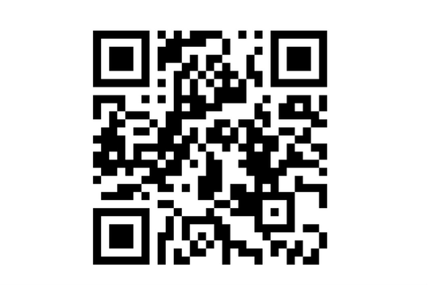
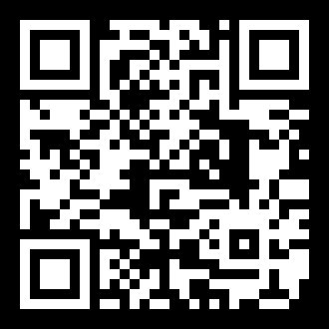
DONATE
BITCOIN MAINNET · ON-CHAIN PROOF
REFRESH THE TREE.
ONE TRANSACTION · ONE CAUSE
BTC ADDRESS (P2PKH)
3GEyeURhLVbRWtZL6qN8MoBKseedN6vRjb
WALLET SCREENSHOT · CRYPTO.COM EXPLORER · 2026-06-21
✦
DONATE NOW
SCAN TO DONATE
✓
VERIFY ON-CHAIN
ANY WALLET · ANY AMOUNT
Cross-check on mempool.space, blockchain.com, or your own node. No middleman, no custodian, no off-ledger.
THE TREE OF LIBERTY · 03 / 03

